Slide 1

CVR COLLEGE OF ENGINEERING (An UGC Autonomous Institute, Accredited by NAAC with ‘A’ Grade) Department of CSE B. Tech CSE-G III Year II Semester
Industrial Oriented Mini Project
Project Title : Recipe and Meal Planning App
23B81A05DT K Sidhu 23B81A05DW U Srinivasulu 23B81A05DY P Sujay Chandra Reddy
Supervisor – Ms.Annabathula Lalitha

Slide 2
Abstract
This project develops a Recipe and Meal Planning Application that helps users manage recipes, schedule meals, and prepare grocery lists efficiently. Users can create or import recipes with structured ingredients, instructions, and images, while a dynamic unit conversion engine adjusts measurements based on serving size accurately.It also includes a calendar-based meal planner that automatically generates a consolidated shopping list by combining ingredients from scheduled meals. The backend is built using Java with Spring Boot, MongoDB ensures reliable data storage and Frontend is built using React, Tailwind CSS and JavaScript

Slide 3
Problem Statement
With the increasing demand for smart meal management, traditional meal planning methods suffer from:
• Lack of clarity in deciding daily meals • Wastage of leftover ingredients • No proper budget planning for meals • Manual grocery list preparation • Limited personalized diet planning
Lack of community interaction in recipe platforms
There is a need for an efficient, automated, and personalized meal planning system.

Slide 4
Literature Survey
Author | Year | Findings | Benefits / Contribution
1. Gupta et al. | 2024 | Proposed a budget-aware meal planning system that filters recipes based on real-time ingredient pricing. | Enabled cost-conscious cooking decisions and reduced household food expenditure.
2. Sharma & Reddy | 2023 | Implemented JWT-based authentication and role management in a food delivery web application using Spring Boot. | Enhanced data security, user access control, and stateless session management.
3. Lee et al. | 2023 | Designed a weekly meal scheduler integrated with an auto-generated grocery list feature for diet tracking. | Reduced manual meal planning effort and streamlined weekly grocery shopping
4. Fernandez & Nair | 2022 | Developed a nutrition analytics dashboard displaying calorie and protein intake using visual charts for diet monitoring. | Enabled data-driven dietary decisions through pie and bar chart visualizations.
5. Mehta & Joshi | 2022 | Integrated a time-based and category-based recipe filtering mechanism in a cooking assistance mobile application. | Improved time efficiency in recipe discovery and reduced decision fatigue for users.

Slide 5
Project Objectives
Recipe Recommendation
Leftover Ingredient Suggestions
Budget-Based Recipe Filtering
Time-Based Meal Filter
Meal Schedule Planner
Auto Grocery List Generator
Personalized Recipe Feed
Weekly Diet Analytics Dashboard
Meal Reminder Notifications
Social Interaction Layer

Slide 6
Existing System: Yummly Website
Traditional Systems Static recipe browsing Manual meal planning Separate grocery list preparation
Limitations No automated meal scheduling Manual grocery planning No budget-based filtering Limited personalization No diet analytics or reminders

Slide 7
Proposed System
The proposed system introduces:
Recipe Creation & Management
Time-Based Recipe Filtering
Budget-Based Meal Planning
Leftover Ingredient Suggestions
Meal Schedule Planner
Auto Grocery List Generator
Personalized Recipe Feed
Recipe Like & Feedback System

Slide 8
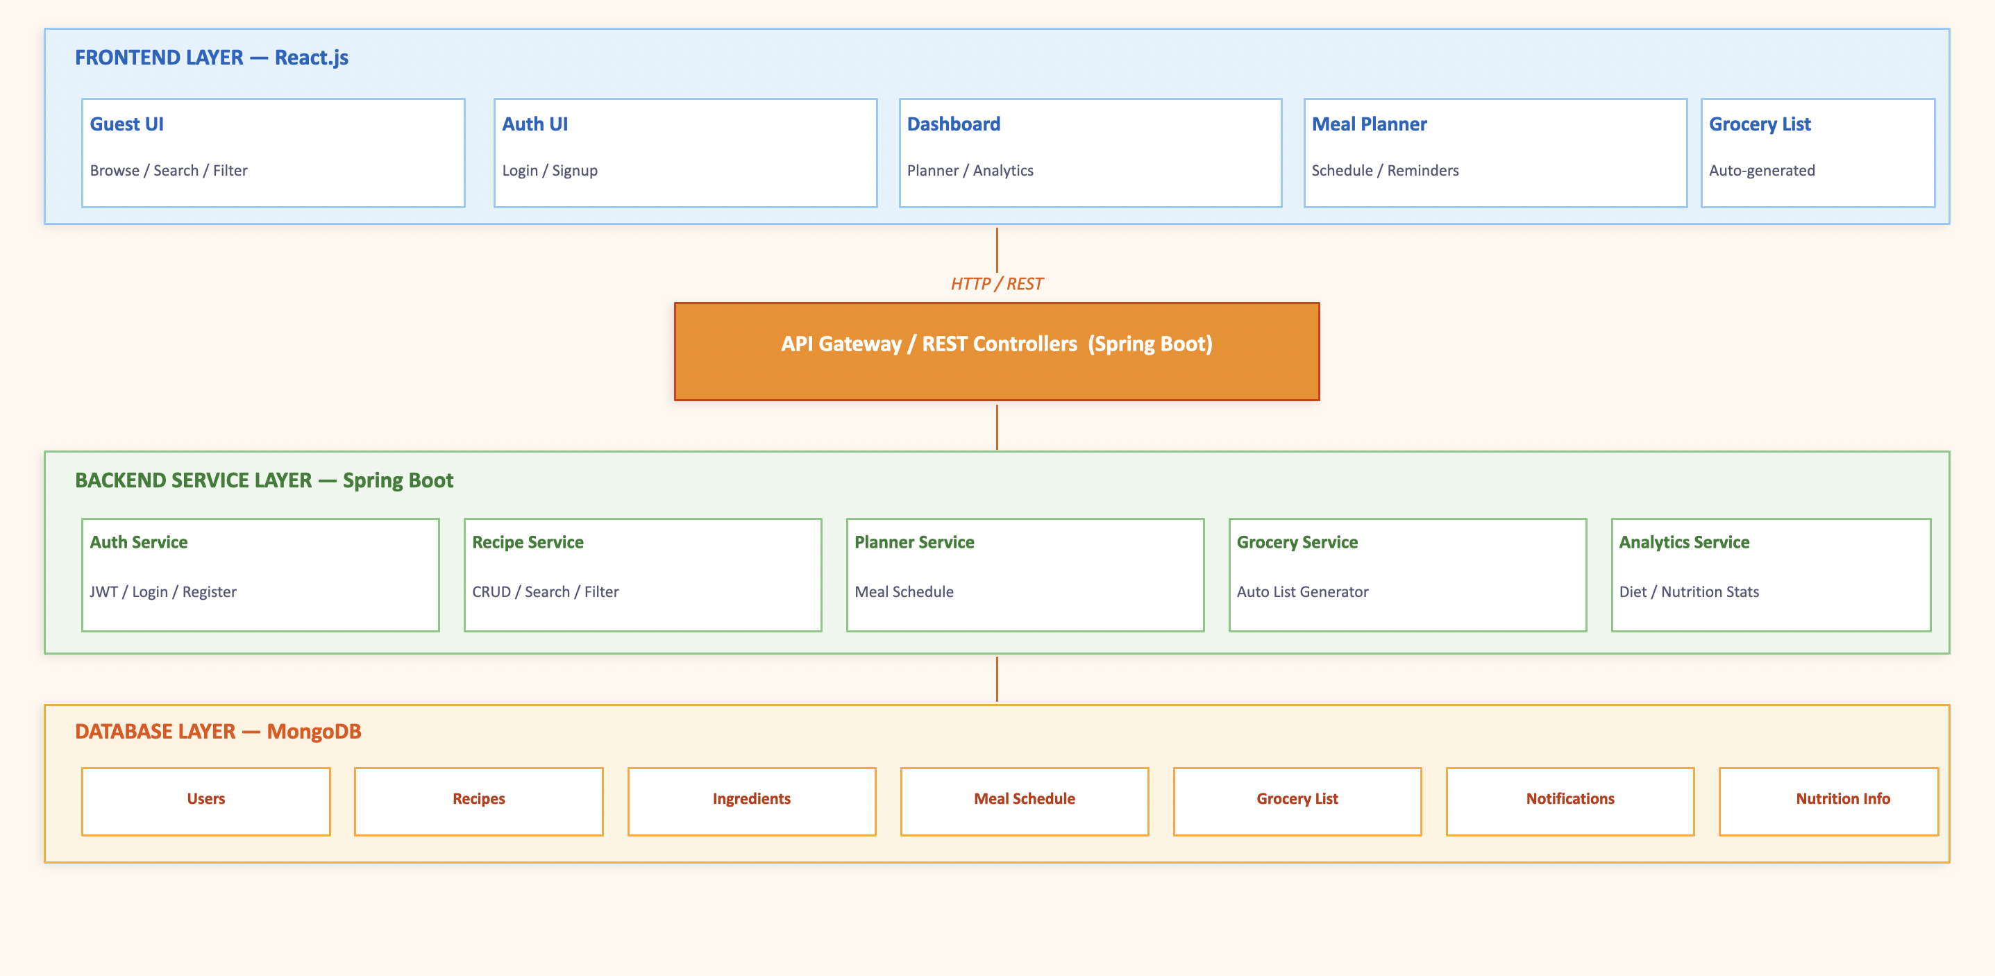
System Architecture

Slide 9
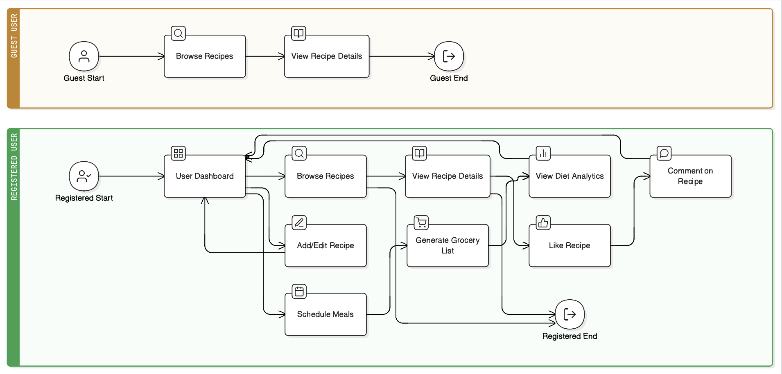
Workflow Diagram

Slide 10
Technology Stack
Frontend: • React.js • Tailwind CSS • JavaScript • React Router DOM
Backend: • Spring Boot (Java)
Database: • MongoDB
Authentication: • JWT (JSON Web Token)

Slide 11
Core Modules
User Management Module
• User Registration
• Login Authentication (JWT)
• Profile Management
2. Recipe Management Module
• Add / Import Recipe
• Ingredient Management
• Step-by-Step Instructions
• Image Upload
3. Meal Planning Module
• Weekly Meal Scheduler
• Personalized Today Feed
• Favorite Recipes
4. Grocery Management Module
• Auto Grocery List Generation
• Ingredient Aggregation
• Duplicate Removal
• Quantity Calculation
5. Diet Analytics Module
• Weekly Diet Analytics Dashboard
• Budget-Based Filtering
• Nutrition Tracking
• Consumption Insights
6. Social Interaction Module
• Like Recipes
• Add/Delete Comments
• Engagement Tracking

Slide 12
Requirements
Functional Requirements
Non-Functional Requirements
User Authentication
Recipe Management
Time & Budget Filtering
Meal Scheduling
Auto Grocery List
Meal Reminders
High Performance
Secure JWT Authentication
User-Friendly UI
Multi-User Scalability
Cross-Platform Support
Reliable MongoDB Storage

Slide 13
Advantages
Reduces Food Wastage Users enter leftover ingredients at home and the system instantly suggests matching recipes. This ensures no ingredient goes to waste and encourages cooking with what's already available.
Budget Friendly Meals Users set a budget in ₹ and the system filters recipes whose total ingredient cost fits within it. This makes healthy home cooking accessible for students, families, and anyone managing expenses.
Time Efficient Cooking Recipes can be filtered by cooking time — under 15, 30, or 60 minutes — so users always find something that fits their schedule. No more spending extra time browsing when you're hungry and in a hurry.
Personalized Suggestions The homepage feed adapts to each user's meal schedule, diet preferences, and past searches to show the most relevant recipes. Every user gets a unique experience tailored to their lifestyle and taste.
Smart Planning The weekly meal planner automatically generates a grocery list and diet analytics dashboard based on the user's scheduled meals. This takes the guesswork out of meal prep and helps users stay organised and nutrition-aware throughout the week.

Slide 14
Conclusion
The Recipe and Meal Planning simplifies daily meal planning through smart recipe recommendations and automated scheduling.It helps reduce food wastage by generating consolidated grocery lists from planned meals. The system offers personalized diet insights using time and budget-based filtering.Built with MongoDB, it ensures efficient, scalable, and reliable data management.

